Slide 1

INTERACTIVE PERSONAL BUDGET PLANNER USING GRADIO
Tooba E
OIM 7502 • Spring 2025
Notes:
Good afternoon, I’m Tooba.
My presentation is on Gradio.
It is a Python library for building interactive interfaces for data and machine learning tools.

Slide 2

TABLE OF CONTENT
  What is Gradio?
  Use Case for a Data Scientist
  Comparison
  Strengths and Limitations
Real-world Application:
  Creating a Personal Budget Planner
  Application Overview
  Coding Overview
  Access the App
  Live Demonstration
Notes:
A quick overview for today:
I’ve created a Personal Budget Planner app using Gradio, and today I’ll walk through what the library does, why a data scientist would use it, and then demonstrate the tool live.

Slide 3
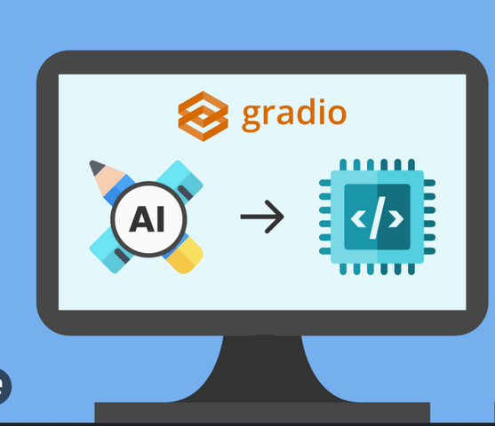
WHAT IS GRADIO?
Definition:
Gradio is a Python library that lets you quickly create interactive web-based user interfaces for machine learning models, data tools, and custom Python functions without needing web development skills.
Key Uses:
  Build demos for ML/AI models
  Create interactive data tools
  Deploy instantly to the web
Notes:
Gradio is a Python library that automatically generates a usable web interface from Python functions.
This solves a common problem in data science. We often build models or analytical tools in notebooks, but nobody outside of the technical team can test or interact with them.
With Gradio, I can take a function, wrap it in an interface, and share it instantly through the web.
No HTML, CSS, JavaScript, Flask, or front-end engineering needed.

Slide 4

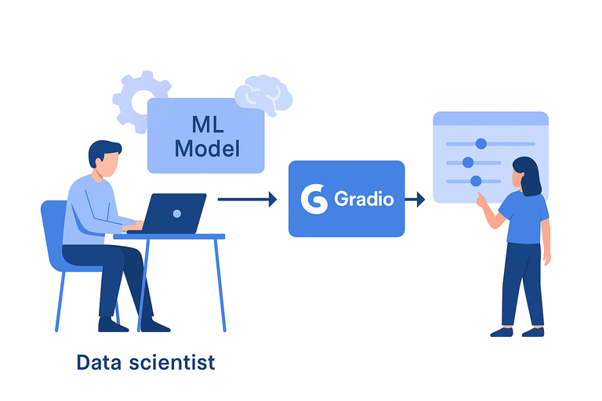

WHY WOULD A DATA SCIENTIST USE IT?
  Speeds up prototyping and experimentation
  Enables non-technical teams (i.e., managers, clients, and professors) to interact with models/tools through a User Interface
  Easy to share via URL → excellent for collaboration or portfolio projects
  Removes dependency on:
  Front-end developers
  Flask/Django setup
Notes:
Gradio is especially useful in collaborative environments.
Imagine working with marketing, operations, executives, or clients - they don’t want to see code. They want to interact with the logic.
Gradio lets me put sliders, dropdowns, images, charts and turn my Python code into a working UI.
This makes it great for:
Experimentation
Displaying model outputs visually
Quick iteration & feedback
Portfolio or client demonstration

Slide 5



COMPARISON: GRADIO vs. STREAMLIT vs. FLASK
Feature | Gradio
Best For | Model Demos + Tools | Full Analytics Apps | Custom Web Backends
Setup Difficulty | Very Easy | Easy | Hard
UI Code Needed | Minimal | Moderate | Full front-end required
Deployment | One-click (Hugging Face) | Requires server setup | Requires full deployment setup
Notes:
Gradio is more plug-and-play, great for quick demos.
Streamlit is better for full dashboards and internal tools.
Flask is for developers building full production apps as it requires HTML/CSS/JS knowledge.

Slide 6

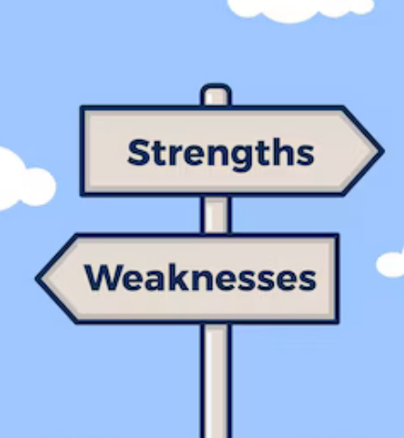
STRENGTHS & LIMITATIONS
  Easy to build and deploy
  Very fast feedback loops
  Works well with ML/Data tools
  Not meant for large business-scale apps
  Styling customization limited
  Requires internet for sharing externally
Notes:
To summarize how Gradio performs in practice, there are some clear strengths, but also some limitations to be aware of.
On the strengths side:
Gradio is extremely easy to build and deploy.
It allows for very fast experimentation, which is great when you're iterating on models or analytical tools.
It’s also designed to integrate well with machine learning workflows and data science code, so there’s no need for separate front-end development or frameworks.
However, Gradio does have some limitations:
It’s not really designed for large-scale, production-level business applications.
The styling and layout customization is limited compared to something like Streamlit or a fully engineered UI.
And because apps are typically shared via hosted links, you do need a stable internet environment to share and collaborate externally.

Slide 7
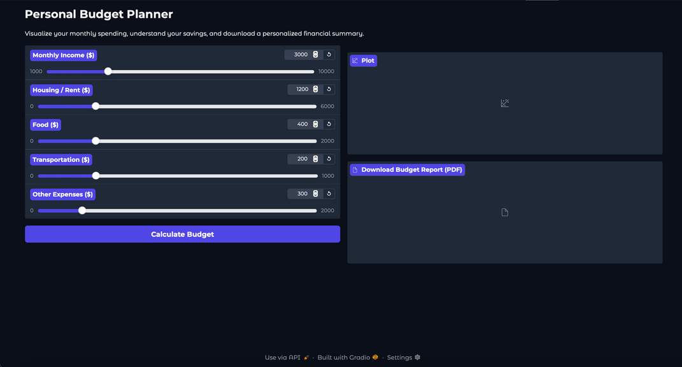
CREATING A PERSONAL BUDGET PLANNER WITH GRADIO
Notes:
Now that we’ve covered what Gradio is and why it’s useful, I want to show how I applied it in a real scenario.
For this project, I built a Personal Budget Planner app entirely in Python, and the interface is created using Gradio.
Budgeting is universal. This tool helps users visualize spending tradeoffs across income and basic cost categories.

Slide 8
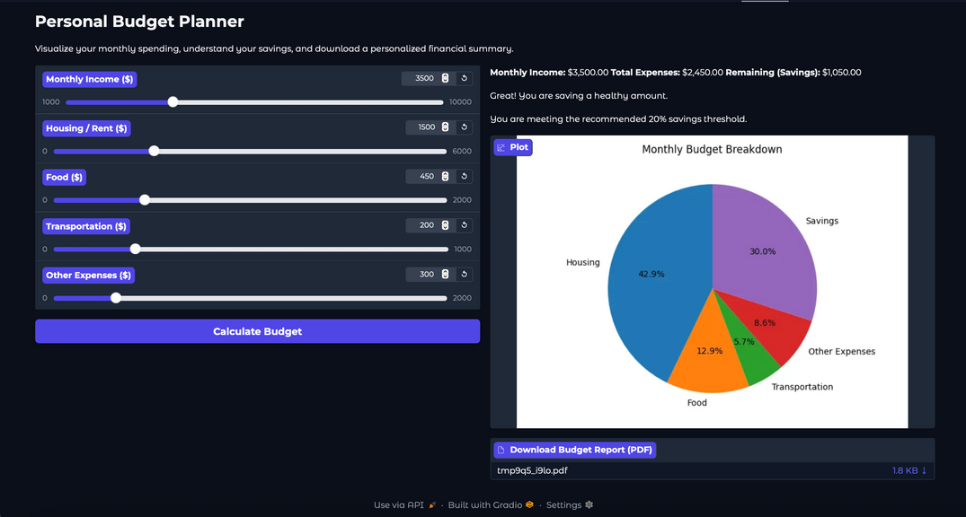
APPLICATION OVERVIEW
  Built in Python using Gradio
  User inputs in key spending categories: monthly income, housing/rent, food, transportation, and other expenses
  Coded calculation in Python automatically displays the savings and shows breakdown of monthly spending
You can:
  Interact with budget sliders
  Save/download your results as a PDF
  Have a visual of spending habits in pie chart form
Notes:
How it works:
The user enters their monthly income and then adjusts sliders for their major spending categories: housing or rent, food, transportation, and any other expenses.
Once the values are entered, the app automatically calculates three things:
The total monthly expenses
How much savings remain
And whether the spending pattern is healthy or overshooting
In addition to the text summary, the app also generates a pie chart that visually breaks down how the user’s money is being allocated.
This makes it easy to quickly see where most of the budget is going.
The user also has the option to download a personalized PDF report.

Slide 9
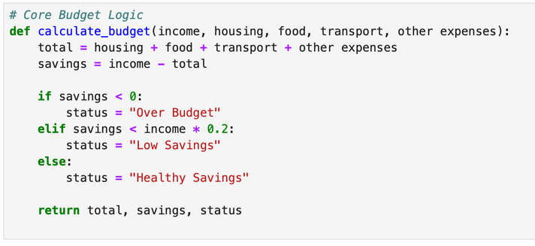
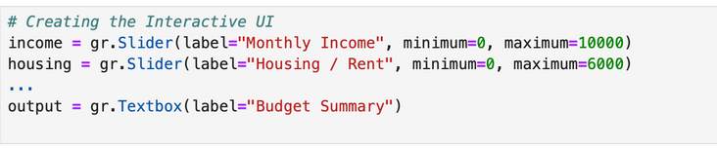
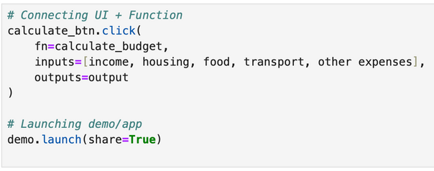
CODING OVERVIEW
01
  This is the core function that calculates the budget
  User inputs their income and expenses
  We sum expenses, subtract to get savings, and then classify whether they are over budget, break-even, or saving
02
  Gradio connects core function to sliders and text output boxes, making it interactive
  The textbox displays a text summary of savings and budget status
  Gradio generates interface automatically
03
  When user clicks button, function runs using those input values, and shows results
  Call demo.launch()
  That’s what creates the live web app you see
Notes:
Now I’ll walk through how the code behind the app all. I’ve simplified it into three parts so it’s easy to follow: the core budget function, the UI layer, and the app launch.
Part 1: Core Function
First, this is the core Python function that performs the financial logic.
It takes the user’s income and expense inputs, adds the expenses together, calculates the remaining savings, and then assigns a budget status.
For example, whether someone is overspending, in a break-even situation, or saving a healthy amount.
This function is where all the actual calculation happens.
Part 2: UI Layer
Next, Gradio is used to build the interface.
Instead of writing any HTML or JavaScript, I just define sliders for each spending input, and a text output box to display the summary.
Gradio automatically connects the UI components to the function, so whatever values the user changes are passed directly into the calculation in real time.
This is what makes the app interactive.
Part 3: Launching the App
Finally, everything gets wrapped together inside a gr.Blocks() layout.
And we publish the app publicly just by calling demo.launch().
That single line is what turns the Python script into a shareable web application which is how I was able to host this on Hugging Face so that anyone can use it.

Slide 10

ACCESS THE APP
01
Visit:
https://huggingface.co/spaces/Toobaaaa/personal-budget-planner
02
Scan the QR code:
Notes:
Before I move into the live demo, here is the link where you can access the app yourself.
If you'd like to try it, you can either visit the URL shown here or simply scan the QR code on the right.
This will open the live Gradio app hosted on Hugging Face Spaces.
You’ll be able to interact with the budget sliders, see the spending breakdown visual, and even download a personalized PDF summary.
Feel free to follow along during the demonstration, or you can explore it later.
It will stay available online after this presentation.

Slide 11
LIVE DEMONSTRATION
Notes:
I'll start by entering a baseline income amount.
Now if I increase rent or food significantly, notice how real-time savings changes.
The pie chart updates visually, and this helps users understand proportion.
And here, I can download a personalized PDF report, which makes this functional for real-life budgeting.

Slide 12
THANK YOU
Notes:
Gradio helps bridge the gap between technical analysis and human understanding.
This project illustrates how a simple Python workflow can become an interactive, shareable tool without web development knowledge.
Thank you!

